Slide 1
METS at the Library of Congress
Nate Trail
Sept 11, 2014
Notes:
Notes
I have drawn heavily from past presentations because they still represent what we’re doing; some redesigns have happened, but it’s basically the same; we’ve gone from prototyping in production to actually producing for the main library’s production system.
Coordinated colors
Pay particular attention to the graphs, charts, and text boxes.
Consider that attendees will print in black and white or grayscale. Run a test print to make sure your colors work when printed in pure black and white and grayscale.
Graphics, tables, and graphs
Keep it simple: If possible, use consistent, non-distracting styles and colors.
Label all graphs and tables.

Slide 2
METS History at LC
2002 – METS and MODS released
2003 – “Patriotic Melodies” (first use of METS and MODS in production at LC)
2003 – Veterans History Project released. 88,000 veteran “story” records.
2004 – I Hear America Singing released (since renamed to Performing Arts Encyclopedia) 30,000 objects, mostly sheet music, scores.
2006 – National Digital Newspaper Project (LC and partners, first use of METS, MODS, MIX, PREMIS) as repository submission package at LC)
2006 – Ser2Dig (Digital Serials workgroup, METS for multi-volume monographs)
2008 and ongoing – Harvesting American Memory Performing Arts digital objects
2014 – Songs of America released: integrating METS objects into the Library’s one search box redesign: 110,000 Performing Arts items

Slide 3

METS Profiles in use at LC
Print Material (books, pamphlets, sheet music, etc.)
Musical Score (may be a score, score and parts, or a set of parts only)
Recorded Event (audio or video)
Bibliographic Record
Photograph
Collection
Newspapers
PDF Document, CompactDisc, StreamingVideo, StreamingAudio

Slide 4
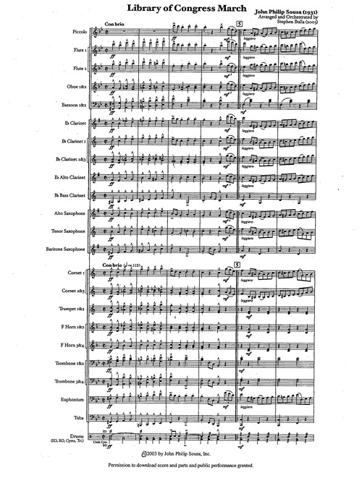
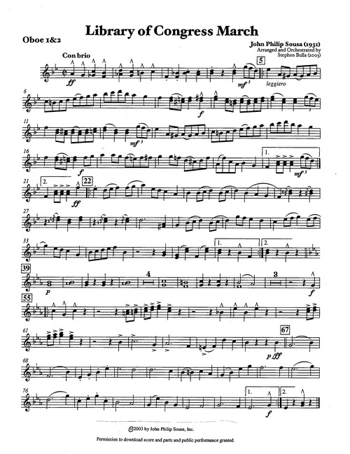
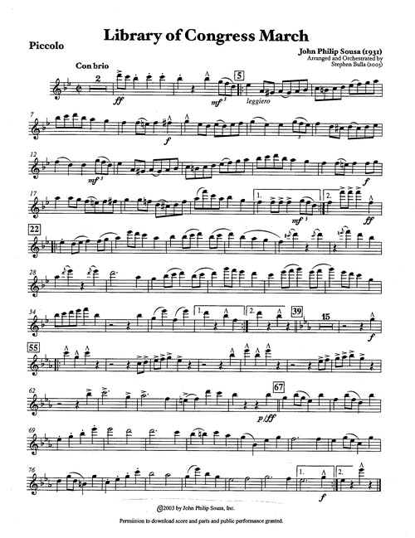
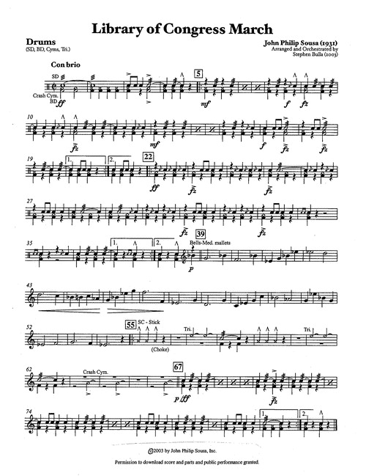
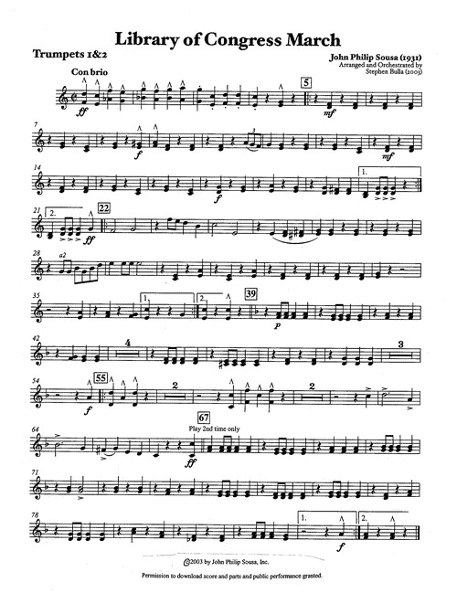
Score/parts Profile

Slide 5

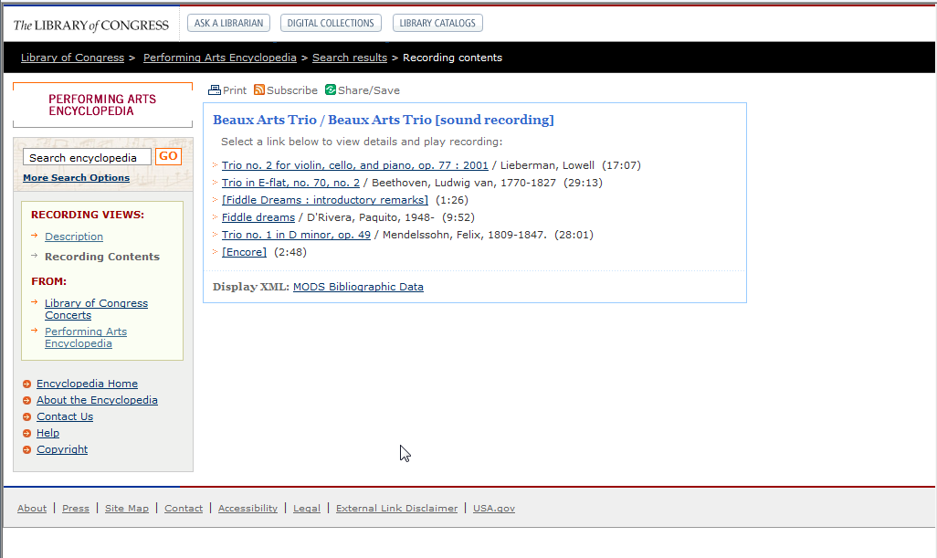
Recorded Event

Slide 6
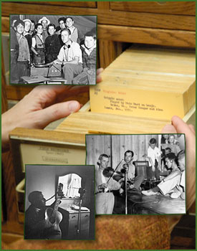
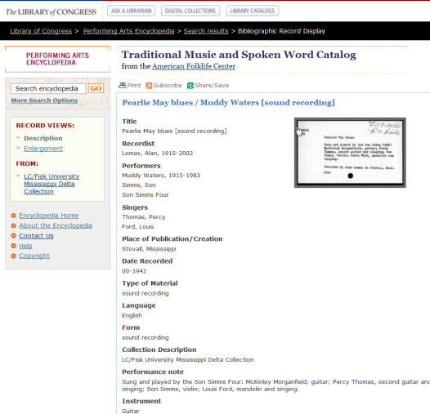
Bibliographic Record

Slide 7
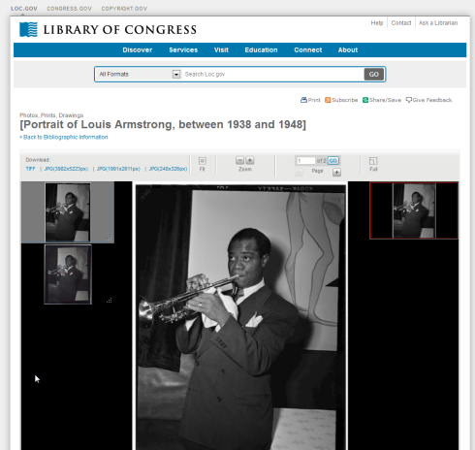
Photograph with PREMIS
Notes:
Includes PREMIS (Preservation Metadata), MIX metadata.

Slide 8
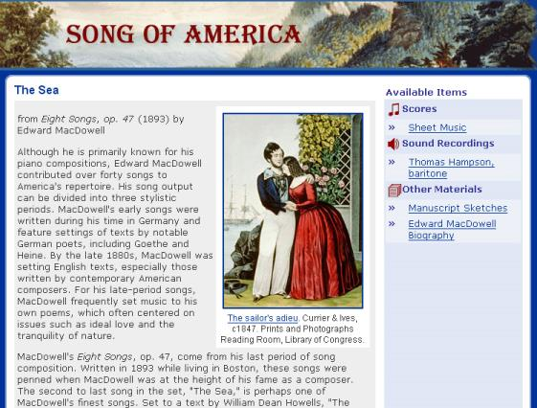
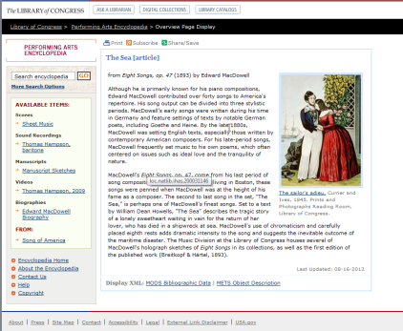
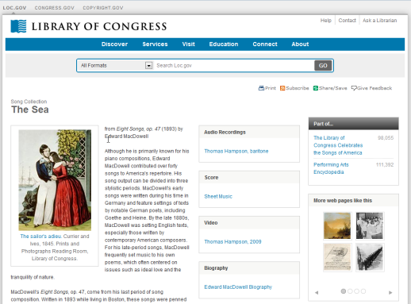
Collection

Slide 9
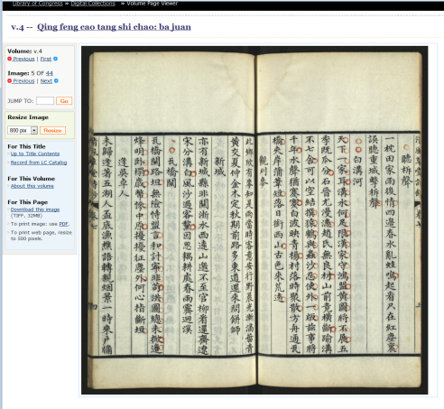
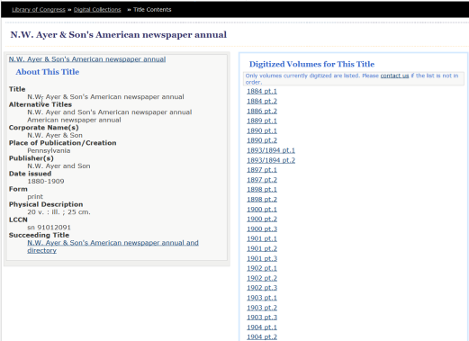
Multivolumes

Slide 10
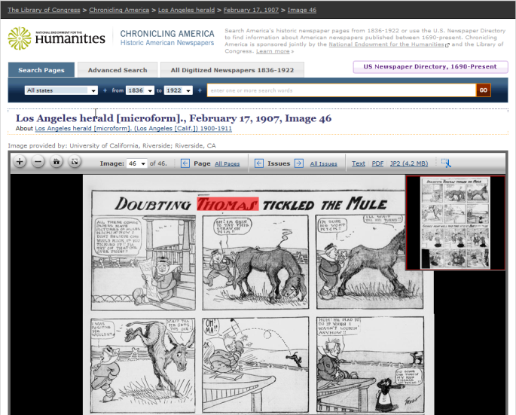
Collection Newspaper
Notes:
8 Million Pages

Slide 11
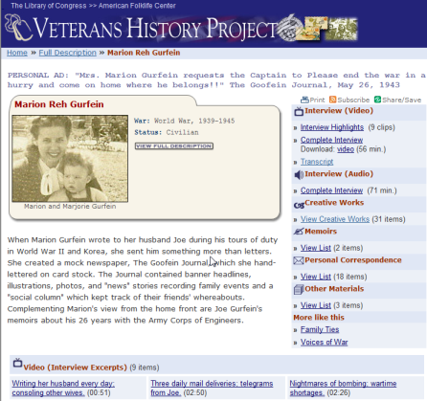
Collection (Veteran Story)
Notes:
Multiple object types linked, with mods metadata for titles, captions, timings.

Slide 12
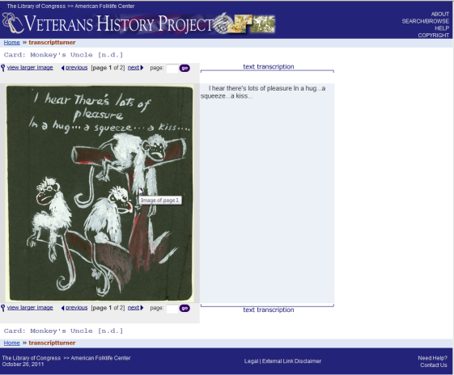
TEI in METS

Slide 13
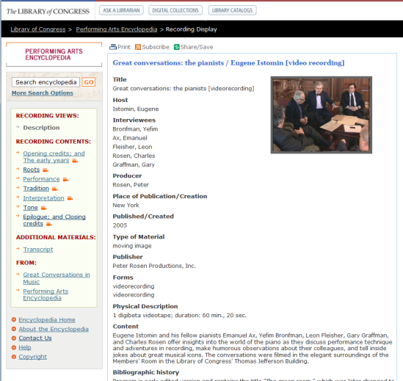
TEI in METS

Slide 14
Advantages of METS-based approach
Ability to model complex objects
Easy to change, extend (both the data and the application)
Stable Schema
Separates the layers of a digital object nicely: logical/physical structure, bibliographic and admin metadata, file locations.
Does not constrain how an object is presented
Ability to aggregate disparate data sources, data schemes
Well positioned for Future: new web application (Web 2.0)
Notes:
Emphasize stability

Slide 15
Questions?
METS at the Library of Congress
Nate Trail
Sept 11, 2014
ntra@loc.gov

